Slide 1
ONE STOP PLATFORM
HUUGE
No minimum spending & Free delivery
G1 Team 7 - Carmen, Zhehai (John), Qing Yu, Tian Feng, Yee Khai and Lin Kai
Notes:
Good afternoon prof, instructor and classmates. We are team 7, consisting of Carmen, John,, Qing Yu, Tian Feng, Yeekhai and myself, and we are presenting to you our solution, HUUGE.

Slide 2
Table of contents
01
02
03
Project Overview
User Scenarios
Our Datastores
04
05
Any Beyond the Lab
Demonstration
Notes:
This is the content we’ll be going through today.

Slide 3
01
Project Overview
Notes:
Moving on to our project overview

Slide 4
About us
The purpose of this project is to tackle an existing pain point - websites that sell gym equipment are often filled with a plethora of useless information and variable add-ons meant to squeeze more out of the customer.
Our team has come up with HUUGE, a one-stop, lightweight e-commerce platform for like-minded potential gym-goers to have affordable clothing and gym equipment they can sweat in, finding inspiration in and a community they can become best at.
Notes:
Gym-goers like to keep things simple. Even though there are countless foods that are high in protein, gym-goers all over the world stick to chicken breast. However, this simplicity is not replicated on websites that sell gym equipment, we found that they are often filled with useless information and add-ons meant to squeeze the most out of a customer. Our team hence came up with HUUGE, a one-stop, lightweight e-commerce platform that sells gym equipment. Our platform ensures that whether you’re a customer, store owner or delivery driver, the clean and crisp user experience will leave you wanting more.

Slide 5
02
Application Flow
Notes:
Lets go into our application flow

Slide 6
Authentication System
Driven by flask-login with additional quality-of-life improvements
 | flask_login default | HUUGE
Hashed password for security
Permanent sessions for convenience
Interactive password checking
Notes:
Our authentication system is driven by the lask-login library, but with additional quality-of-life improvements. Our application uses Werkzeug’s generate_password_hash and check_password_hash to hash passwords when users sign up as we know how important security is to users. Instead of the default volatile sessions that Flask has, we have permanent sessions up to ten minutes so users don’t have to log in again whenever they close their browser. Lastly, we have an interactive password checking to make users lives simpler, such as telling them how many more password characters they need to meet the minimum requirements. I will now pass my time on to Qing Yu for our user scenarios.

Slide 7
03
User
Scenario

Slide 8
Overall Business Scenario
01
02
03
Guest places an order
Customer checkout the cart
Driver process booking
Notes:
There will be 3 user scenarios, there’s actually four users but we are going to cover the 3 in our user scenarios. Firstly, the guest will place an order, then customer can checkout the cart and lastly driver will pick and delivers the items. As for the last user is store owner which we will not be going through but we have functions for it.

Slide 9
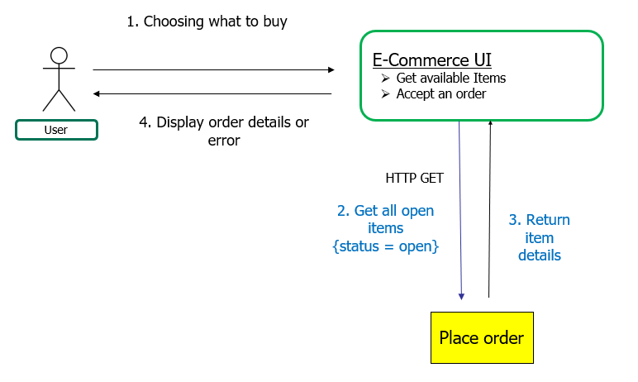
Scenario 1 - Guest places an order
Notes:
This is the scenario 1, the guest will place an order with a click of buy now. This will proceed to place order and triggers payment.

Slide 10
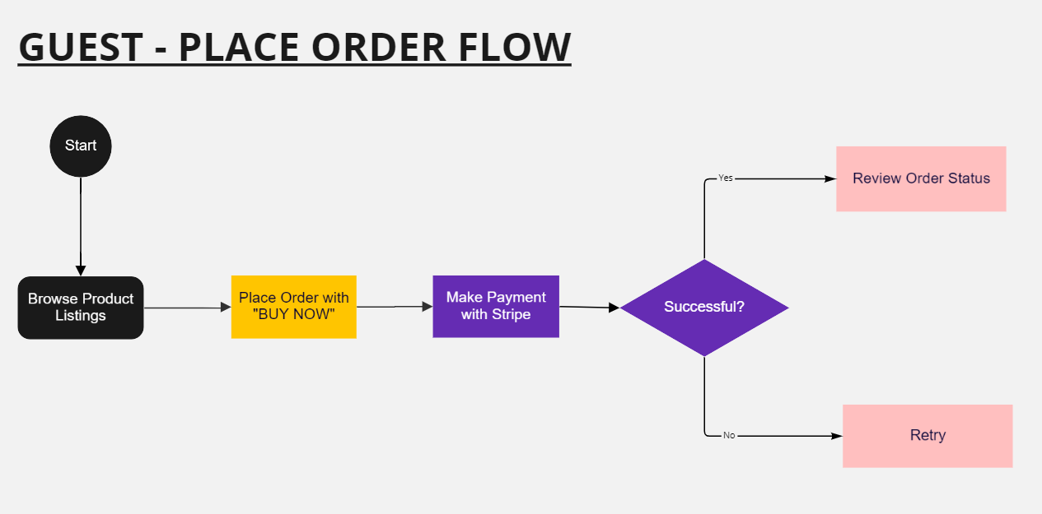
Scenario 1

Slide 11
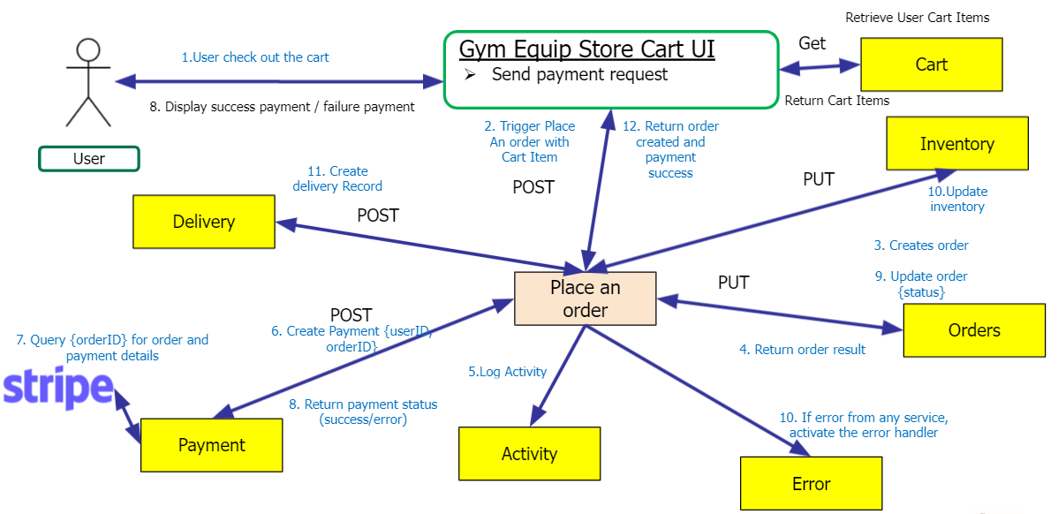
Scenario 2 - Customer checkout the order from cart

Slide 12
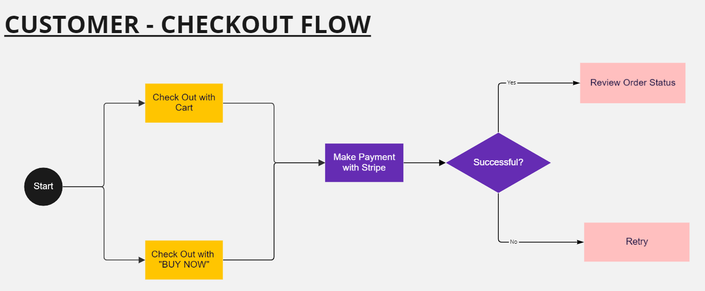
Scenario 2

Slide 13
Scenario 3 - Driver process delivery
Order
4. Return booking requests
HTTP
3. Update order status to 4 (delivered)
Process delivery
4. Return successful update delivery
1. Driver completes the order
Delivery
2. Return successful message
3. Updates a delivery record
HTTP
Gym Equip Store Admin UI
Driver accepts booking

Slide 14
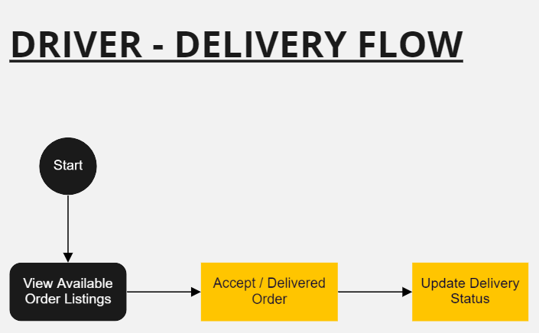
Scenario 3

Slide 15
04
Data
Stores

Slide 16


Gym Equip Store UI
Place an order
Delivery
Get all delivery records
[GET]/delivery
Get specific delivery record
[GET]/delivery/orderID
Create delivery record
[POST]/delivery
Update delivery record
[PUT]/delivery/orderID
Get delivery record by status
[POST]/delivery/status
Application/UI Name
Menu Items
Delivery
Delivery
DeliveryID (INT) (auto increment)
DriverName (VARCHAR)
DriverID (INT)
DateCreated (VARCHAR)
DeliveryStatus (VARCHAR)
OrderID (INT)
Complex Service
Operations
Place an Order
Place an order
[POST] /place_order
Microservices
Order
Cart
Payment
Error Log
Activity Log
Create new order
[POST] /order
Update order
[PUT] /order/orderID
Get orders status
[GET] /order/status
Insert/Update order
[POST] /order/orderID
Get all orders
[GET] /order
Get order by id
[GET] /order/order_id
Create new cart
[POST] /newCart/custID
Get Cart for customer
[GET] /newCart/custId
Cart update
[PUT]//updateCart/custID
Process payment
[POST] /payment
Get payment status
[GET] /payment
Create checkout sessions by calling Stripe API
[BKEY] order.error
(Reply via [RKEY] *.error)
[BKEY] order.info
(Reply via [RKEY] #)
Order
OrderID (INT) (auto increment)
custID (INT)
Items (VARCHAR)
DateCreated (VARCHAR)
Total_Price (FLOAT)
Delivery_Address (VARCHAR)
Status (VARCHAR) (0,1,2,3,4)
Order_Item
itemID (INT) (auto increment)
orderID (INT)
productiD (INT)
quantity (Int)
Inventory
Update inventory
[PUT] /inventory
Update inventory by individual items
[PUT]/updateInventory/productID
Delete equipment
[DELETE]/inventory/productID
Add equipment
[POST]/inventory/productID
Cart
Find equipment by ID
[GET]/inventory/productID
Get all equipment
[GET]/inventory
custID (INT)
productID (INT)
productName (VARCHAR)
quantity (INT)
price (DOUBLE)
Inventory
Order
productID (INT)
name (INT)
product_type (VARCHAR)
quantity (INT)
price (DOUBLE)
Notes:
Order sql data format
Kong microservice

Slide 17
Gym Equip Store UI
Place an order
Application/UI Name
Menu Items
Complex Service
Operations
Process Delivery
Process delivery
[POST] /process-delivery
Microservices
Order
Delivery
Error Log
Activity Log
Update order
[PUT] /order/orderID
Get orders status
[GET] /order/status
[BKEY] order.error
(Reply via [RKEY] *.error)
[BKEY] order.info
(Reply via [RKEY] #)
Update Delivery
[POST] /process-delivery
Delivery
Order
OrderID (INT) (auto increment)
custID (INT)
Items (VARCHAR)
DateCreated (VARCHAR)
Total_Price (FLOAT)
Delivery_Address (VARCHAR)
Status (VARCHAR) (0,1,2,3,4)
Order_Item
itemID (INT) (auto increment)
orderID (INT)
productiD (INT)
quantity (Int)
Delivery
DeliveryID (INT) (auto increment)
DriverName (VARCHAR)
DriverID (INT)
DateCreated (VARCHAR)
DeliveryStatus (VARCHAR)
OrderID (INT)
Order
Notes:
Order sql data format
Kong microservice

Slide 18
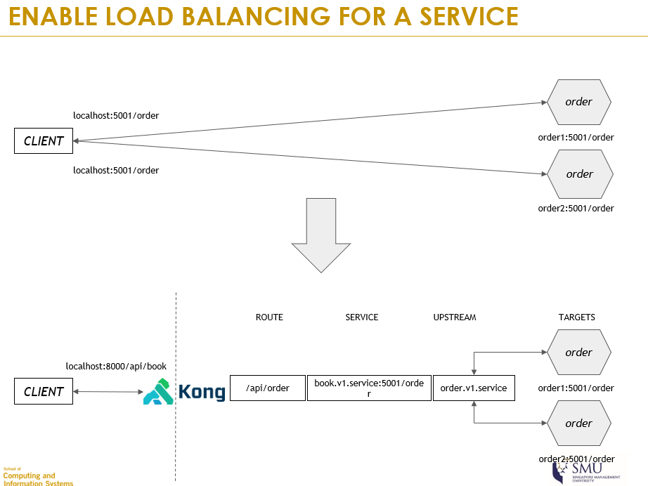
Beyond the lab
KONG
Notes:
A load balancer is a device that acts as a reverse proxy and distributes network or application traffic across a number of servers. Load balancers are used to increase capacity (concurrent users) and reliability of our applications.
-KONG Service Routing - Improving the security by allow one or multiple routes pointed to a single service.

Slide 19
05
Demonstration

Slide 20
Thanks!
Do you have any questions?

